Slide 1


Slide 2
Data Operations with LINQ
IN710 OOSD 2016
Session 10.1

Slide 3
Working with Data
Filtering
Ordering
Grouping
Summarising
Notes:
Thus far we have concentrated on architecture and computation. But IRL, computation doesn’t serve much purpose without data.
Few real enterprise applications exist that don’t use data.
This week we are going to talk about some important .NET classes for data management, especially database-style operations like grouping, summarising and filtering (searching with condition)
We will look today at working with data in memory (i.e. objects that you create at runtime, just like usual).
This is the fastest way to process data, and you should use it if you can.
Of course, very quickly, data sets can get too big for handling in memory, so you have to go external.
We will talk about external data sources next time
Fortunately, the syntax for internal and external data management is the same.
We learn the syntax now, and the transfer is easy (in actual fact, when we go external, the system brings in a copy of the data we need and makes it into class objects automatically, so it really is identical).
A critical feature of this technique is how much it depends on lambda. You will need to be very comfortable with lambda to use it.

Slide 4
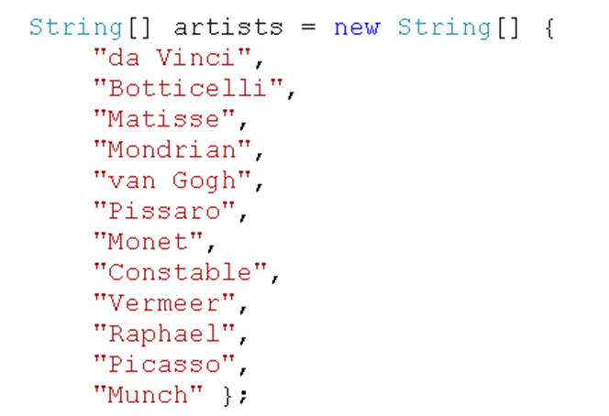
Example
Notes:
Assume this array
Think of traditional code to display all elements that start with m…

Slide 5
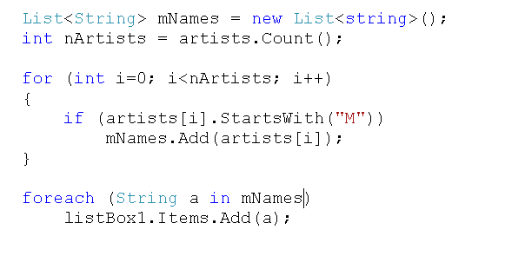
Traditional Iterate and Filter
Notes:
get all the artists whose name starts with M.

Slide 6
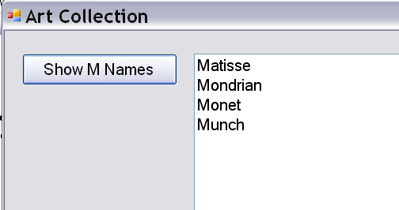
Output

Slide 7
LINQ
Language INtegrated Query
Less verbose than traditional approach
Works with IEnumerable objects
A set of extension methods
These methods return IEnumerable collections of elements
Notes:
.NET provides an alternative
Recall that an IEnumerable object is one who implements the IEnumerable interface.
Essentially, anything you can put in a foreach loop
Extension methods are static methods attached to an existing interface or class.
You then foreach (or whatever) over the return value to display the results
There are a couple dozen LINQ commands. We will look at the most common and useful, and leave the others as an exercise.

Slide 8
.Where
For filtering
InputCollection.Where(predicateExpression)
Returns an IEnumerable collection of all elements in inputCollection for which predicateExpression evaluates to true
artists.Where(a => a.StartsWith("M"));
Notes:
The most basic LINQ command is “.Where”, for filtering.
You will remember that a predicate is any function that accepts input and returns a bool based on some condition
predicateExpression is most conveniently given as a lambda
Here is how the preceding code would look using LINQ
The Where method iterates over the collection artists
The variable ‘a’ is a placeholder that is bound to each element of artists in turn. It is equivalent to the placeholder variable we use in foreach statements.
We call the StartsWith method of the String class here.
The lambda returns true if a starts with M
For each member of the enumerable, if the lambda evaluates to true, that member is added to the return set.
(Remember that we don’t have to specify the type of the input to a lambda if it can be inferred. Here since artists is a string collection, a is clearly a string, so no problems.)

Slide 9

.Where
Notes:
Before we see the actual code, what type of variable will we use to capture the output of the .Where command? => IEnumerable, not List. The LINQ commands return the interface type, not a concrete type.
Here is the complete code to select and print
You can see that it is shorter than the traditional looping code.
Note that you can also give the Where clause a raw delegate, but it must follow a specific, somewhat cumbersome format. Left as an exercise. Lambda is preferred.

Slide 10
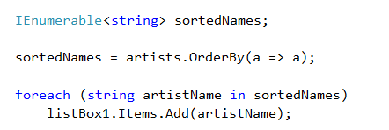
.OrderBy
Notes:
The purpose of LINQ is to provide database functionality
Therefore, it pretty much duplicates SQL
Including orderby
Note the lambda here. “For each a return a”. Therefore “order artists by string”
Note that you can also achieve the same result with the collection’s built-in sort, but we look at OrderBy here because we will next combine it with the other LINQ commands

Slide 11
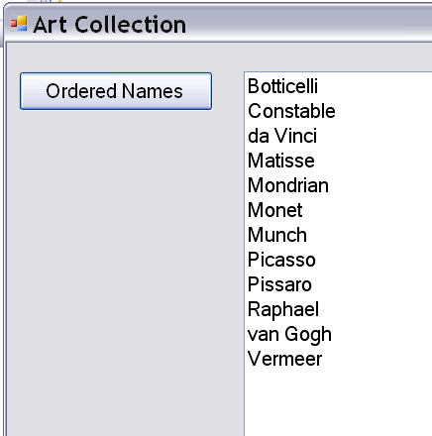
.OrderBy
Notes:
Output from the preceding code

Slide 12
Combining LINQ Commands
.Where outputs an IEnumerable.
.OrderBy takes an IEnumerable as input.
Thus you can use the output of .Where as the input to .OrderBy
collection.Where(pred1).OrderBy(pred2)
Notes:
The syntax isn’t quite what we’re used to.
We might expect orderBy(collection.Where()) or similar
This syntax is the syntax of functional languages (which you should recall from Programming 4)
.NET has decided to use it.
You will also recognise this as jQuery style if you are doing Web 3

Slide 13
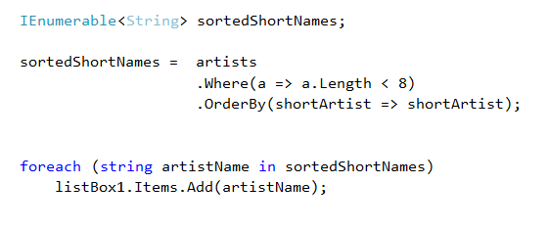
Combining LINQ Commands
Find all artists whose names have fewer than 8 characters, and print in sort order.
Notes:
How would you…
Note that you can use any variable name you want in the lambdas, they don’t have to be the same.
The system first does the whole Where then the whole OrderBy, it doesn’t pass them through one at a time.
For legibility, you can type it like this, and you will almost always see LINQ formatted this way.

Slide 14
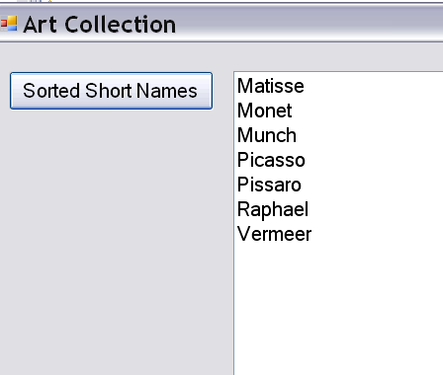
Combining LINQ Commands
Notes:
There are many more LINQ commands.
We will look at a couple of the more important ones in a moment, but we now want to consider using LINQ with complex data objects

Slide 15
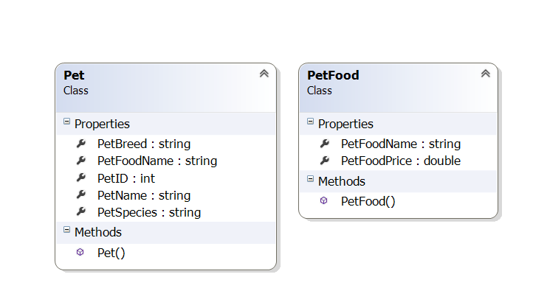
LINQ and Complex Data
Notes:
Assume we are managing data for a very, very small pet store
We have these two classes. One represents a pet and the other represents a kind of food
Each has the fields as shown.
Note that each pet has a string that is the name of its pet food. To get information about that pet food, for example, its price, you would need to iterate over all the available pet foods and look for a match to the string.
An alternative implementation would have been to give the pet a pet food object instance, which would eliminate that looking over step.
In this case, we are using the first method. Can you think why?
Using the first method works better if the subordinate class really defines a set of categories, rather than of individual instances. That is, every pet who has “kibble” as its pet food really has the same kind of pet food – different instances of kibble would not have unique values on their data fields (in fact, you wouldn’t want them to be – all kibble eaters should be paying the same price for kibble), so you don’t really want a bunch of separate instances floating around.
To see the impact, imagine what happens if the price of kibble changes.
With the “hold the name only” implementation, you don’t have to touch any code. All your code to deal with “kibble” looks up kibble in the pet foods collection and uses whatever the current value is, so that is all fine.
With the “give everyone an instance” implementation, you would have to update everybody’s kibble instance.
Obviously, the first is better.
What does this remind you of? => Relational databases. And in fact, that is what LINQ is most frequently used for – letting Visual Studio talk to a RDBMS (as we will see next time). Today, we are using in-memory objects, but we are setting them up to mimic relational tables.
Later, we will see some tools that will automatically take your objects and create a relational database from them. These are called ORM (Object Relational Mapping) tools, and they can be very useful.
In this structure, petFoodName is essentially the PK of Pet food, and an FK in Pet.
Using this structure, you could work out the price of any pet’s food even though the pet doesn’t actually hold that data (by finding the matching petFood and accessing its price)

Slide 16
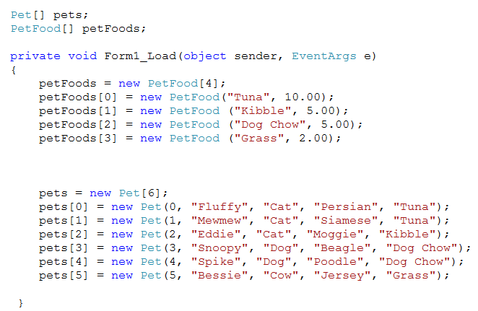
LINQ and Complex Data
Notes:
Here is our little database set up
We have an array of pets and an array of foods (could have used Lists as well)
Just ordinary stuff you have done 1,000,000 times.
Think about the queries you might do on these data: How many cats? Show us everyone who eats tuna? What is the price of each pet’s food? Etc. Etc.
You can imagine how you would write the code using the traditional looping-and-conditionals approach, yes? We won’t go over that
Let’s look at how we could answer various queries using LINQ.
We will start with Where and OrderBy, then add some additional LINQ commands.

Slide 17
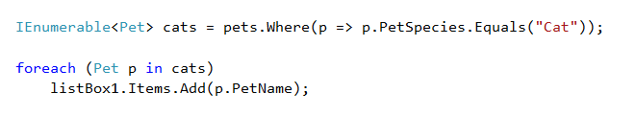
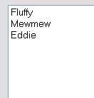
LINQ and Complex Data
List all the cats
Notes:
How would we list all the cats?
We want to use Where to filter, so we need a lambda.
Recall that I have defined Properties for the fields, using the conventional capitalisation.

Slide 18
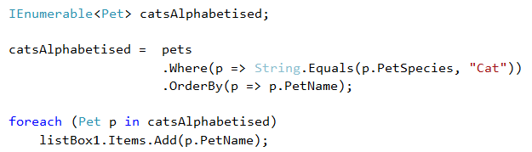

LINQ and Complex Data
List all the cats in alphabetical order by their names.
Notes:
So we use .Where to select the cats, then .OrderBy to alphabetise
Here’s another way to compare strings. Remember that the right hand side of the => can have any function of the variable on the left hand side.
Note that our lambdas can all use different data members of p, just as you would expect.

Slide 19
.Select
Projection
Collection.Select(selectorExpression)
Notes:
So far we have looked at two important data operations – filtering and sorting
There is a third common data operation: projection, the selection and recomposition of field subsets.
In SQL, this is the SELECT query, where you can pull a subset of fields from a database record according to criteria.
In LINQ we have the .Select command
The syntax is much the same as for .Where and .OrderBy, but the lambda is different. ⬅=======
Where needed a boolean predicate; Select needs an expression that tells which fields to return.

Slide 20
.Select
For each pet, display its name and species
pets.Select(p => ?)
What should the lambda return?
Anonymous types
new {field1, field2,…,fieldN}
pets.Select(p => new { p.PetName, p.PetSpecies });
Notes:
Let’s have an example
We want, for each p, to grab the PetName and PetSpecies fields.
Remember that the lambda means “p => thing to return”. So we need to create something here to return.
But what type does this lambda return?
Not clear.
We don’t have a type that contains just the name and species fields.
We want a subset of the fields of an object. There is no class that matches that subset, so what do we return?
Fortunately, we don’t have to commit to an instance of some particular existing type. We can ask for an anonymous typed object.
We have met anonymous before. It just means “an unnamed thing.”
To get an anonymous object, you just say “new {…..}” without a type. The compiler infers the type you want, which is effectively an object with just those fields in it, and creates one.
Like this:
In this context, the compiler realises you want an object with these two data members, and it makes one for you.
These types of objects have a special format when displayed, as we will see in a minute
Now, we must figure out how to store these “objects of unknown type”...

Slide 21
.Select
We have said:
IEnumerable<String> = ...
IEnumerable<Pet> = ...
We have said:
foreach (String s in catNames)...
foreach(Pet p in selectedPets)...
What do we do with anonymous objects since they have no named type?
Use “var”
Notes:
But, we need to store all the returned objects (as we have been doing with IEnumerable<Pet> and IEnumerable<string>) What type is it a collection of?
And we need to print them in the foreach loop, for which we need a type ( as we have said foreach(String s in…
var is a .NET keyword that means “unspecified type”
The compiler will try to infer the correct type from the context. If the compiler can’t do so, you get a compile error; if it can, the thing just runs.

Slide 22
var
Anywhere you can use a regular type (int, List<T>, Pet) you can use var (local variables only)
The compiler will try to figure out (infer) what type you need.
If it can’t, you get a compile error. But if it can, your code will run.
Notes:
Review
Let’s see how we use var to solve our query problem….

Slide 23

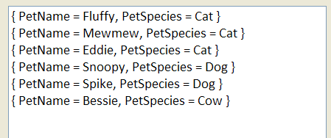
.Select
Notes:
Note that you don’t say “IEnumerable<var>”. The var is the whole type just the way that List<string> is a type (a list of strings).
Note that var can only be used with local variables
Note that when you declare a var, you must initialise it at the same time (i.e. you can’t say var nameSpecies; )
If you don’t, the compiler can, of course, not infer what type it should be
Note the two occurrences of var here: one for the type of the collection itself and one for the type of the elements in the collection
Since those elements are created anonymously, they don’t have a type name, so must be var
The compiler can figure out that they are “those things made anonymously up there”
It knows the type though, you will get code completion for p and everything.
So how does it store and display that anonymous type?
Let’s look…
When you make an anonymous type with .Select, the system makes a struct/record/assoc array, however you like to think of it. Field:Value pairs.
What if we want to format the data….?

Slide 24

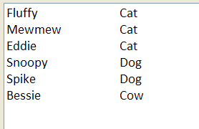
.Select
Notes:
The system knows what fields the objects in nameSpecies have.
You will get code completion just as though it was a user-declared type.
In the select you created new tuples of Petname and PetSpecies
Just as though you had created an object instance that has those two members
And in the foreach, you can access them just as though that’s what they are.

Slide 25
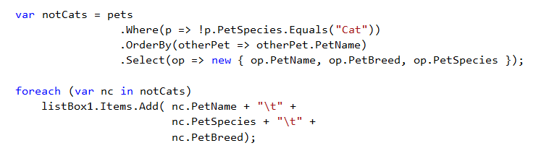

Combining LINQ Commands
Show the name, breed and species of all pets who are not cats, in alphabetical order by name.
Notes:
A more complex example…
As you can see, you can pretty much do all the standard database things with LINQ commands
You can also group, join and summarise (count, min, max, sum and average). We’ll see all those commands later
When you get into more complex queries, however, the syntax – this chain of function calls - can get fairly unwieldy
So .NET offers an alternative syntax…

Slide 26
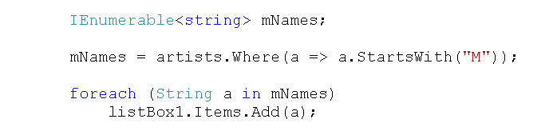
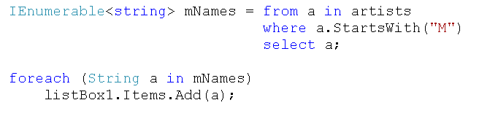
Alternative Syntax: Query Operators
Notes:
LINQ has two syntactic options.
The one we have been using is called Method syntax, because it uses the dot-notation like methods do.
The alternative syntax is called Operator syntax.
The two syntaxes end up with the same executable and you can always use whichever one you prefer.
However, as your LINQ queries get more elaborate, especially when you get into the area of JOIN-equivalent operations, Method syntax starts to get quite cumbersome, and you will generally see people using Operator syntax.
Let’s look...
Remember this?
It can also be written like this…
from and select clauses are required
And it is case sensitive
And the variable names must be the same. This is a pipeline, not a function chain. (The foreach could still be different, of course.)
Note that this looks very much like SQL, except the order is different
In SQL it is SELECT-FROM-WHERE in LINQ it is FROM-WHERE-SELECT
Select always comes last.
So, to do an Orderby….

Slide 27
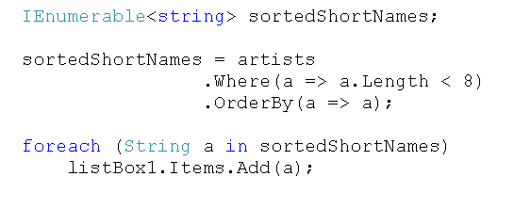
Combining LINQ Commands
Find all artists whose names have fewer than 8 characters, and print in sort order.
Notes:
Remember this?
We did it with method syntax like this….
Just BTW, we don’t use var here because we know we are getting strings

Slide 28
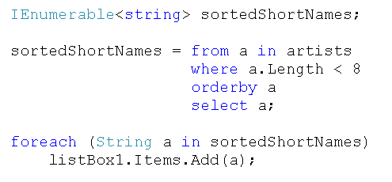
Query Operators
Notes:
In query operator syntax it would be….
Nice and succinct
Compare in your head to traditional looping code as well.

Slide 29
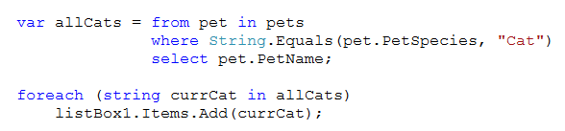
Query Operators with Complex Data
Notes:
Let’s go back to our pets database
What do we think this does?
Answer: prints the names of the cats in database order
Note that, because we know that pet.petName is a string, we can specify its type in the foreach instead of var. Just a little type safety.
If we grab more than one field, we need to var…

Slide 30
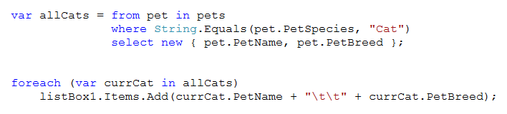

Query Operators with Complex Data
Notes:
What do we think this will do?
Note the var in the foreach.
That’s because we’ve created the new type (fields PetName and PetBreed) on the fly.

Slide 31
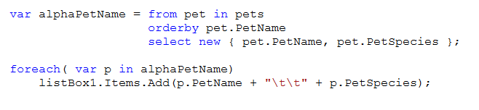
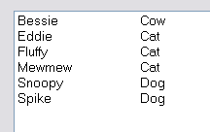
Query Operators with Complex Data
Notes:
What do we think this will do?

Slide 32
.GroupBy
Group does not return a collection of objects
Group returns a collection of IEnumerables, which must be “unpacked”.
Notes:
Another LINQ command: .Group
Is, not surprisingly, for grouping
But Group is a little different from the other three we have seen
It’s kind of like $result in php….

Slide 33

.GroupBy
groupedBySpecies is an IEnumerable collection of anonymously typed IEnumerable “group” objects
There is one object for each group (each value on the grouping field)
Notes:
Using either LINQ method or query operator syntax,
Note that with Query Operator syntax, “group” and “by” are broken up. This are the syntactic anomalies that can make programming harder than it needs to be.
groupedBySpecies is now an IEnumerable collection of anonymous type group objects.
There is one object for each group
Each of these objects is itself IEnumerable.
If we try to just print them out, we see this...
Let’s look at how we can unpack this complex object…

Slide 34
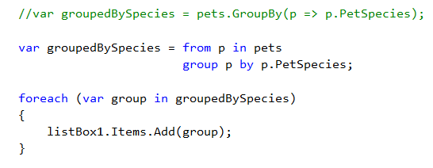
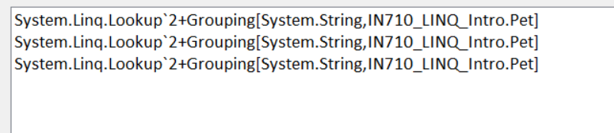
.GroupBy
Notes:
Using either syntax, we group by species and print the returned Ienumerable, it just gives us the (anonymous, temporary) type name.
We need to unpack those three groups...

Slide 35
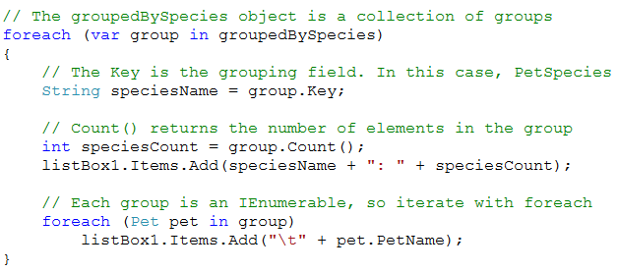
Unpacking Groups
Notes:
Here is how to unpack
Uses nested foreach loops
The complex objects in the collection returned by the .GroupBy function have a number of useful properties and methods. Here we see how to get the group key (the value on the grouping variable for this group), and the number in that group..
Each group object is itself a collection, so it can be iterated over with foreach
Note that you can use Pet as the type in the foreach because you know you were grouping Pets. If you’ve grouped anonymous types, you can use var (actually var works here too, but give yourself type safety when you can).

Slide 36
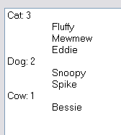
Grouping

Slide 37
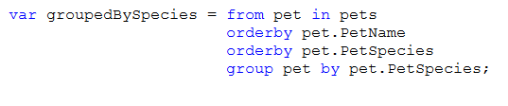
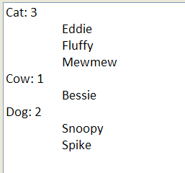
Grouping
Notes:
What does this do?
Here we first order by name, then species, then group by species
When we print it out, the species are alphabetised, and the animals within each species are alphabetised by name
Assume the same unpacking and printing as on the previous slide, here is the output.

Slide 38
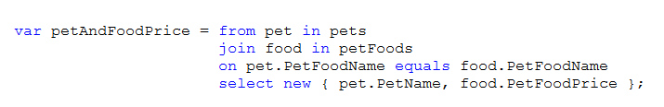
Joining
var joinResult = from varName1 in collection1
join varname2 in collection2
on field equals field
select new {csv fieldList};
Notes:
Not much point in getting all relational if you aren’t going to join
For our pet example, joining allows us to access information about pet food (e.g. price) for each pet by equating its petFood field (FK) to an entry in the foods array (where it is the PK)
It is possible to join with LINQ method syntax, but the syntax is mega-ugly, so we won’t bother.
With query operator syntax, it’s manageable
Here’s the general format (note the various keywords, which are not in italics), and an example from our dataset
Here, for each animal in pets, join to an entry (or entries) in petFoods, matching the PetFoodName fields of the two objects and returning the petName and price fields bundled up into a field:value pair object
Join returns an IEnumerable collection of such objects.
Let’s look…

Slide 39
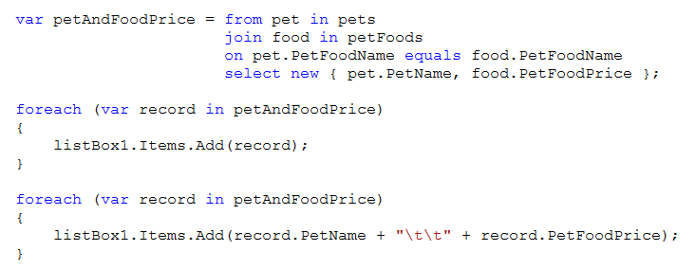
Joining
Notes:
To emphasise the databasey-ness of this computation, I am using “record” in the foreach loops to refer to the individual elements returned by the join. But keep in mind these are ordinary in memory objects, and this is an ordinary forloop. You could call them “nameAndPrice”, or “Bob”, or “v”. Doesn’t matter.
What will we see?
Note that we are first printing out the whole object, then selected fields of it

Slide 40
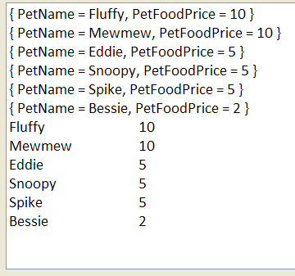
Joining
Notes:
Here it is.
Note, of course, that you could output this quite easily into a dataGridView for that real database look

Slide 41
LINQ
LINQ to Objects
LINQ to XML
LINQ to SQL
Notes:
What we have done today is called “LINQ to Objects”
There are two other application areas for LINQ – XML and SQL
The syntax of LINQ is the same; just the binding is different
Next week we will talk about LINQ to SQL and LINQ to XML if we have time.
This week we will solidify our understanding of the syntax in practical.

Slide 42
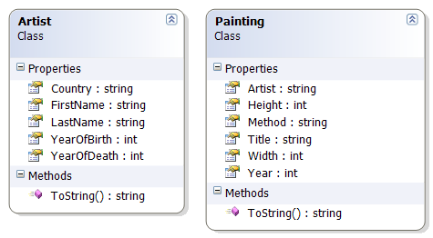
Practical: LINQ to Objects
Notes:
There is a C# skeleton for this practical.
It’s got these two classes
They make a little relational database for your extremely valuable art collection

Slide 43
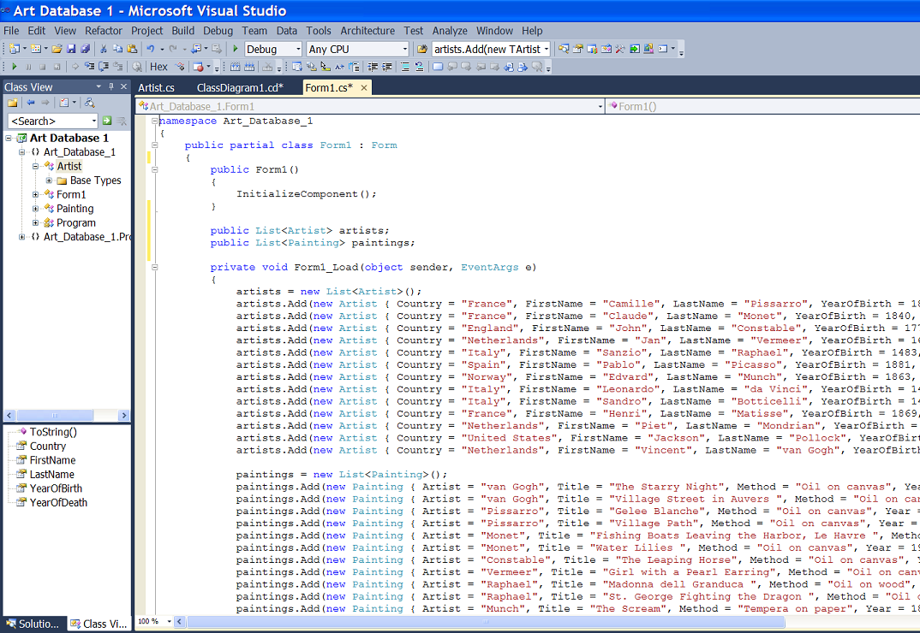
Practical: LINQ to Objects
Notes:
In the formLoad, the arrays “artists and “paintings” have been populated

Slide 44
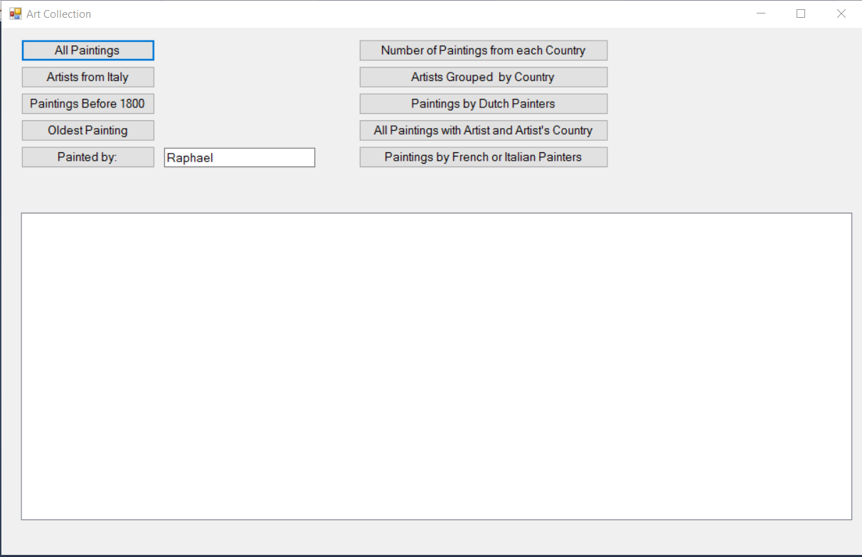
Practical: LINQ to Objects
Notes:
The form has a bunch of buttons on it (all hopefully self-explanatory)
For each button, you write the handler
There is a running demo to show the required output formats (and in case the button labels aren’t as clear as I think)

